Slide 1
第二次实验
秦华谦
21312683

Slide 2
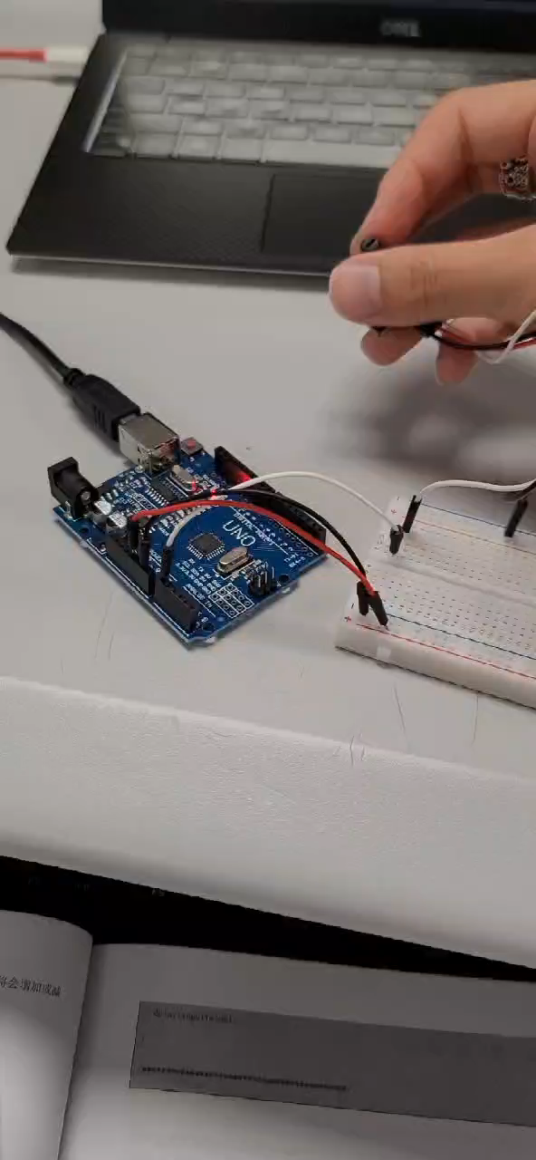
实验一：电位器实验
const int analogPin = A0;
const int ledPin = 13;
int inputValue = 0;
void setup() {
// put your setup code here, to run once:
pinMode(ledPin,OUTPUT);
Serial.begin(9600); }
void loop() {
// put your main code here, to run repeatedly:
inputValue = analogRead(analogPin);
digitalWrite(ledPin,HIGH);
delay(inputValue);
digitalWrite(ledPin,LOW);
delay(inputValue);
}

Slide 3
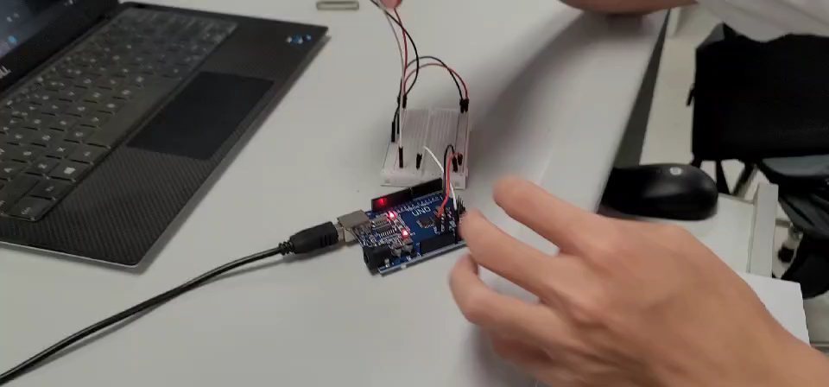
实验二：声音传感器实验
const int ledPin = 13;
const int soundPin = A0;
void setup()
{
pinMode(ledPin,OUTPUT);
Serial.begin(9600);
}
void loop()
{
int value = analogRead(soundPin);
Serial.println(value);
if(value>600)
{
digitalWrite(ledPin, HIGH);
delay(200);
}
else
{
digitalWrite(ledPin, LOW);
}
}

Slide 4
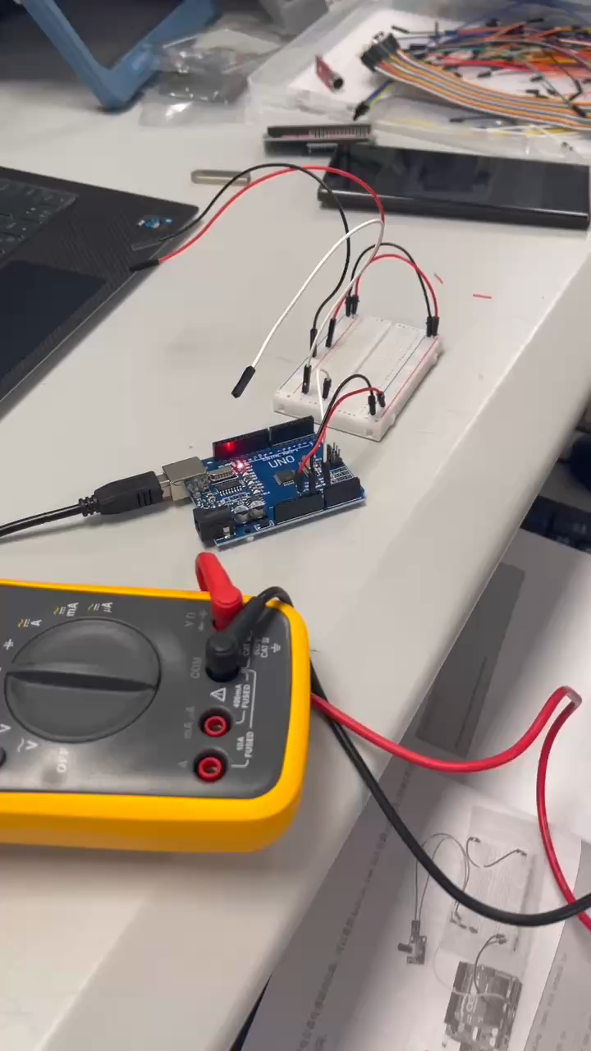
应变片实验：

Slide 5
附加题1：PART-1
#include <Wire.h>
#include <LiquidCrystal_I2C.h>
char array1[]="Sound Level: "; //the string to print on the LCD
int tim = 500; //the value of the delay time
int soundPin = A0; //assuming the sound signal is connected to analog pin A0
LiquidCrystal_I2C lcd(0x27, 16, 2);
//set the LCD address to 0x27 for a 16 chars and 2 line display
void setup()
{
lcd.init(); //initialize the led
lcd.backlight(); //open the backlight
Serial.begin(9600);
}

Slide 6
附加题1：PART-2
void loop()
{
lcd.clear(); //Clears the LCD screen and positions the cursor in the upper-left corner.
lcd.setCursor(0, 0); //set the cursor to column 0, line 0
lcd.print(array1); //print the string to LCD
int value = analogRead(soundPin); //read the value from the sound sensor
value = (value - 80) * 10;
if(value < 0)
value = 0;
lcd.setCursor(0, 1); //set the cursor to column 0, line 1
lcd.print(value); //print the value to the LCD
Serial.println(value); //also print the value to the Serial monitor
delay(tim); //wait for 500 milliseconds
}

Slide 7
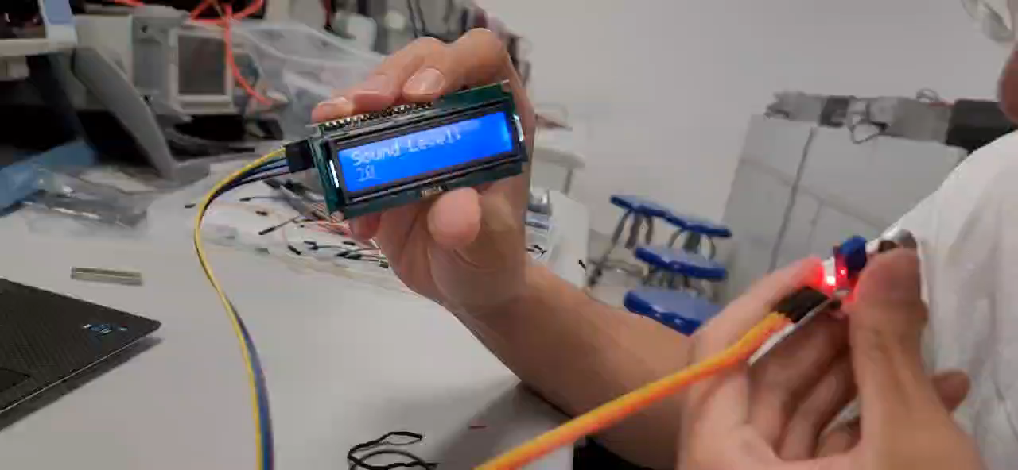
附加题1：PART-3

Slide 8
GitHub仓库：
https://github.com/pbcn2/Code-of-Sensor-Principle-And-Application-exp

